Slide 1

Cyclistic Case Study
Converting Casual Riders Into Members
By Chevar Pryce

Slide 2
Contents
1
2
3
4
What is Our Goal?
The Data
Define our goal and the questions we will answer to reach it
Detailing the data we do and do not have
Key Findings
Recommendations
What did we discover from the data
Detailing where the findings lead us and possible steps forward

Slide 3
Goal & Questions
Support the Marketing team in developing strategies to convert Casuals
Into
Members
How do Casual Riders and annual Members use Cyclistic bikes differently?
How can we use these differences and similarities to target Casual riders?
Casuals = Cyclistic riders who use single-day/ride passes | Members = Cyclistic Annual Subscribers

Slide 4
Data Summary
Data We Have
Data We DON’T Have
Ride Start/End Date & Time
-
SOME Ride Start/End Stations
-
Ride Length
-
Ride Types
-
Ride ID’s
Any Rider Identification
-
Rider Income Information
-
Rider Location
-
Rider Survey Information
-
Pricing Information
-
Any Rider Demographics

Slide 5
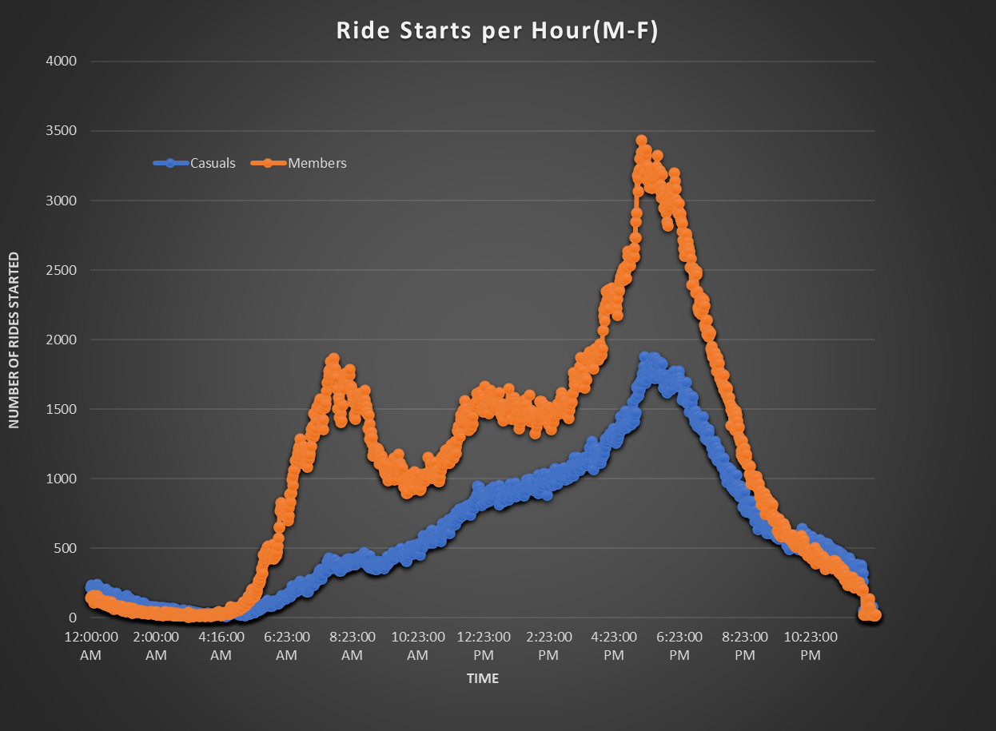
Key Findings
When They Ride - Time of Day
Casuals
Usage grows throughout the day and peaks during the afternoon rush hour
It’s possible
Members
Usage peaks during rush hours
Strong trend towards general commuting times

Slide 6
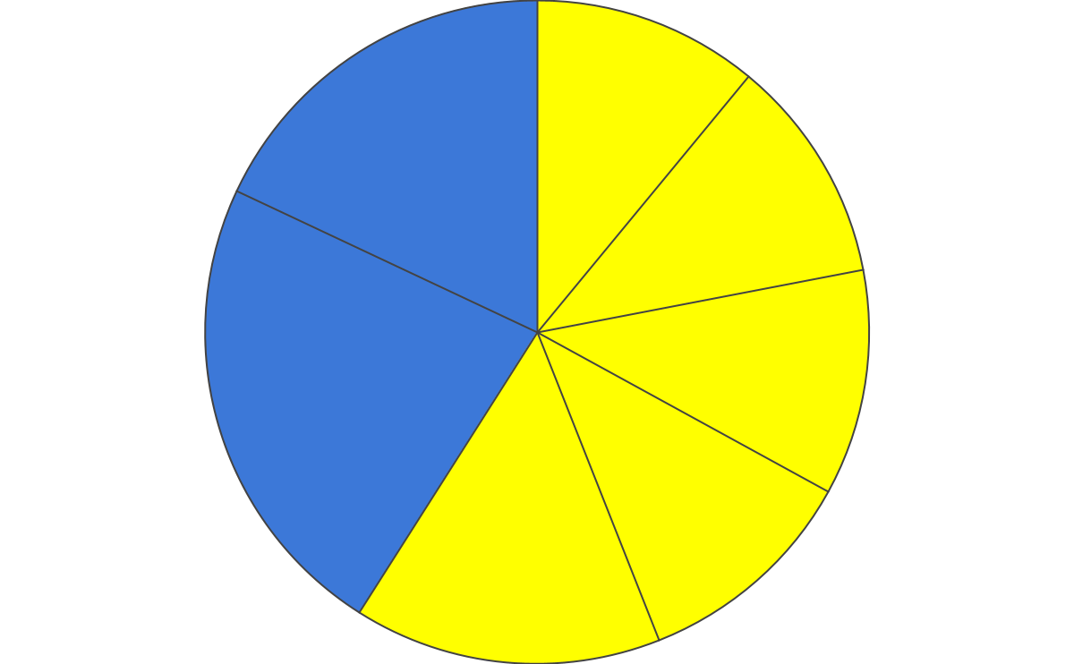
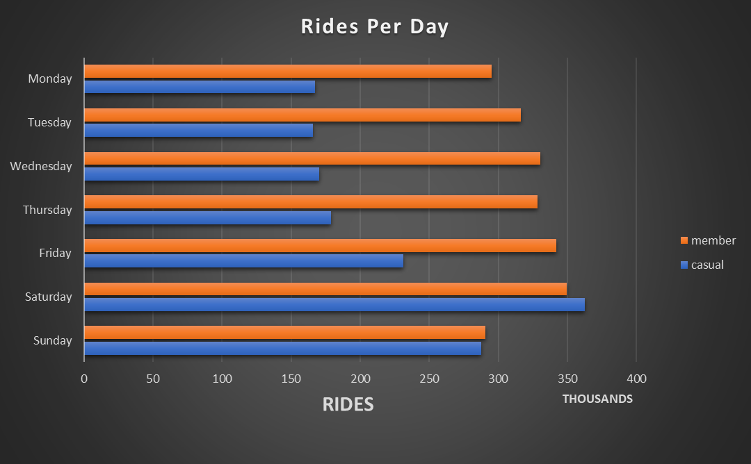
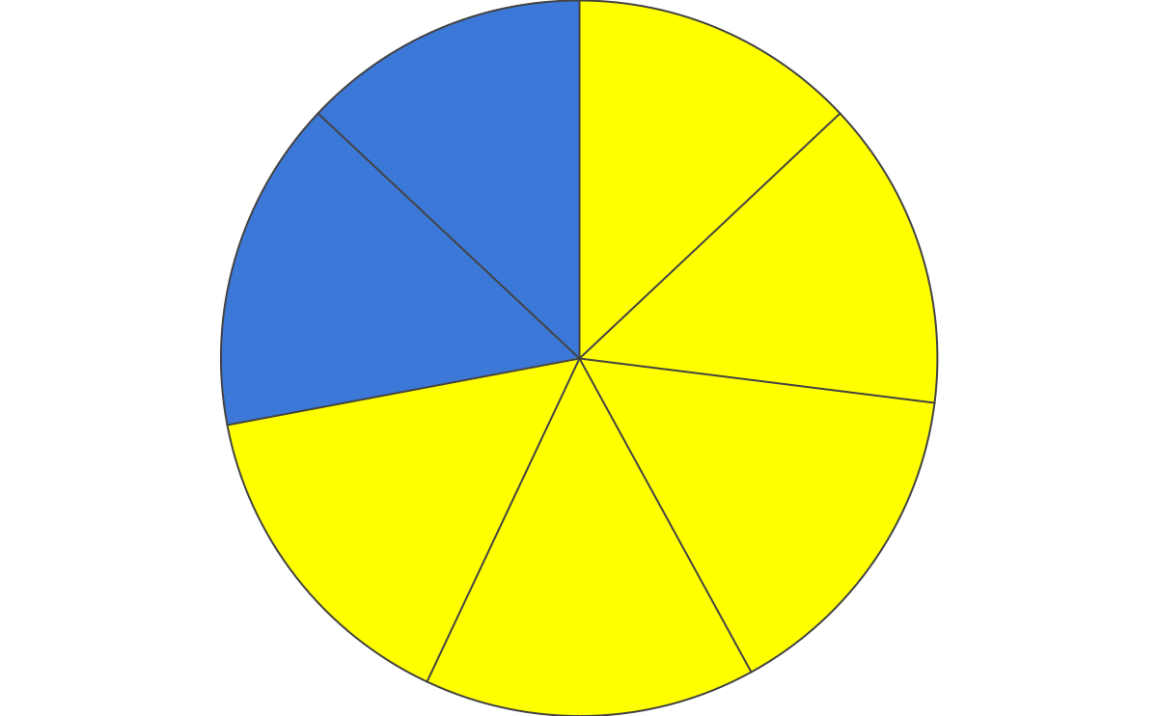
Key Findings
When They Ride - Day of the Week
Casuals
Prefer riding on the weekends
Rides peak on Saturday, doubling M-Th rides
SN
18%
M
11%
T
11%
S
23%
W
11%
F
15%
TH
11%
Members
Consistent riders everyday
Difference between most and least popular day is 2%
Sn
13%
M
13%
S
15%
T
14%
F
15%
W
15%
Th
15%

Slide 7
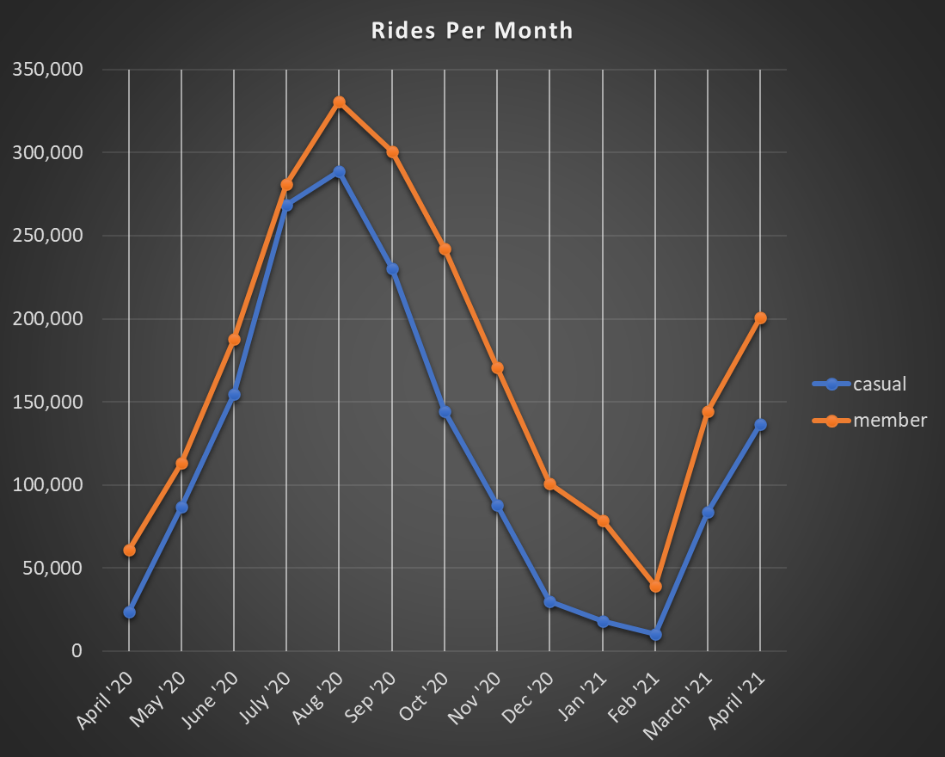
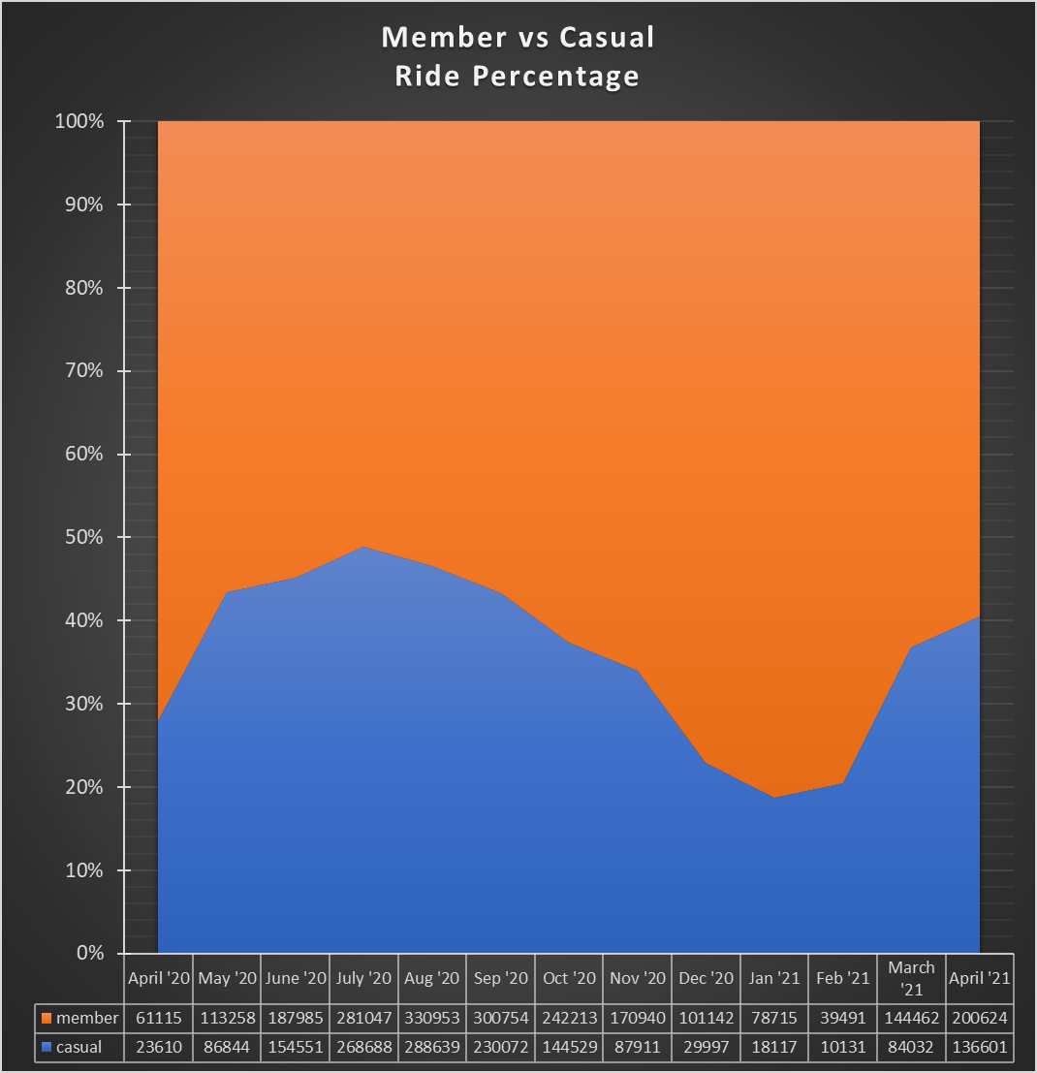
Key Findings
When They Ride - Seasons
Casuals
Trends are similar to Members
Don’t like riding in the Winter
Accounts for less than 20% of all rides in Winter
Members
Does not like riding in Winter but still rides
Possibly due to commutes, dominates Winter ride % at a little over 80%
*Ride numbers start in 2020 around the time when COVID restrictions occurred, so numbers may not be completely normal

Slide 8
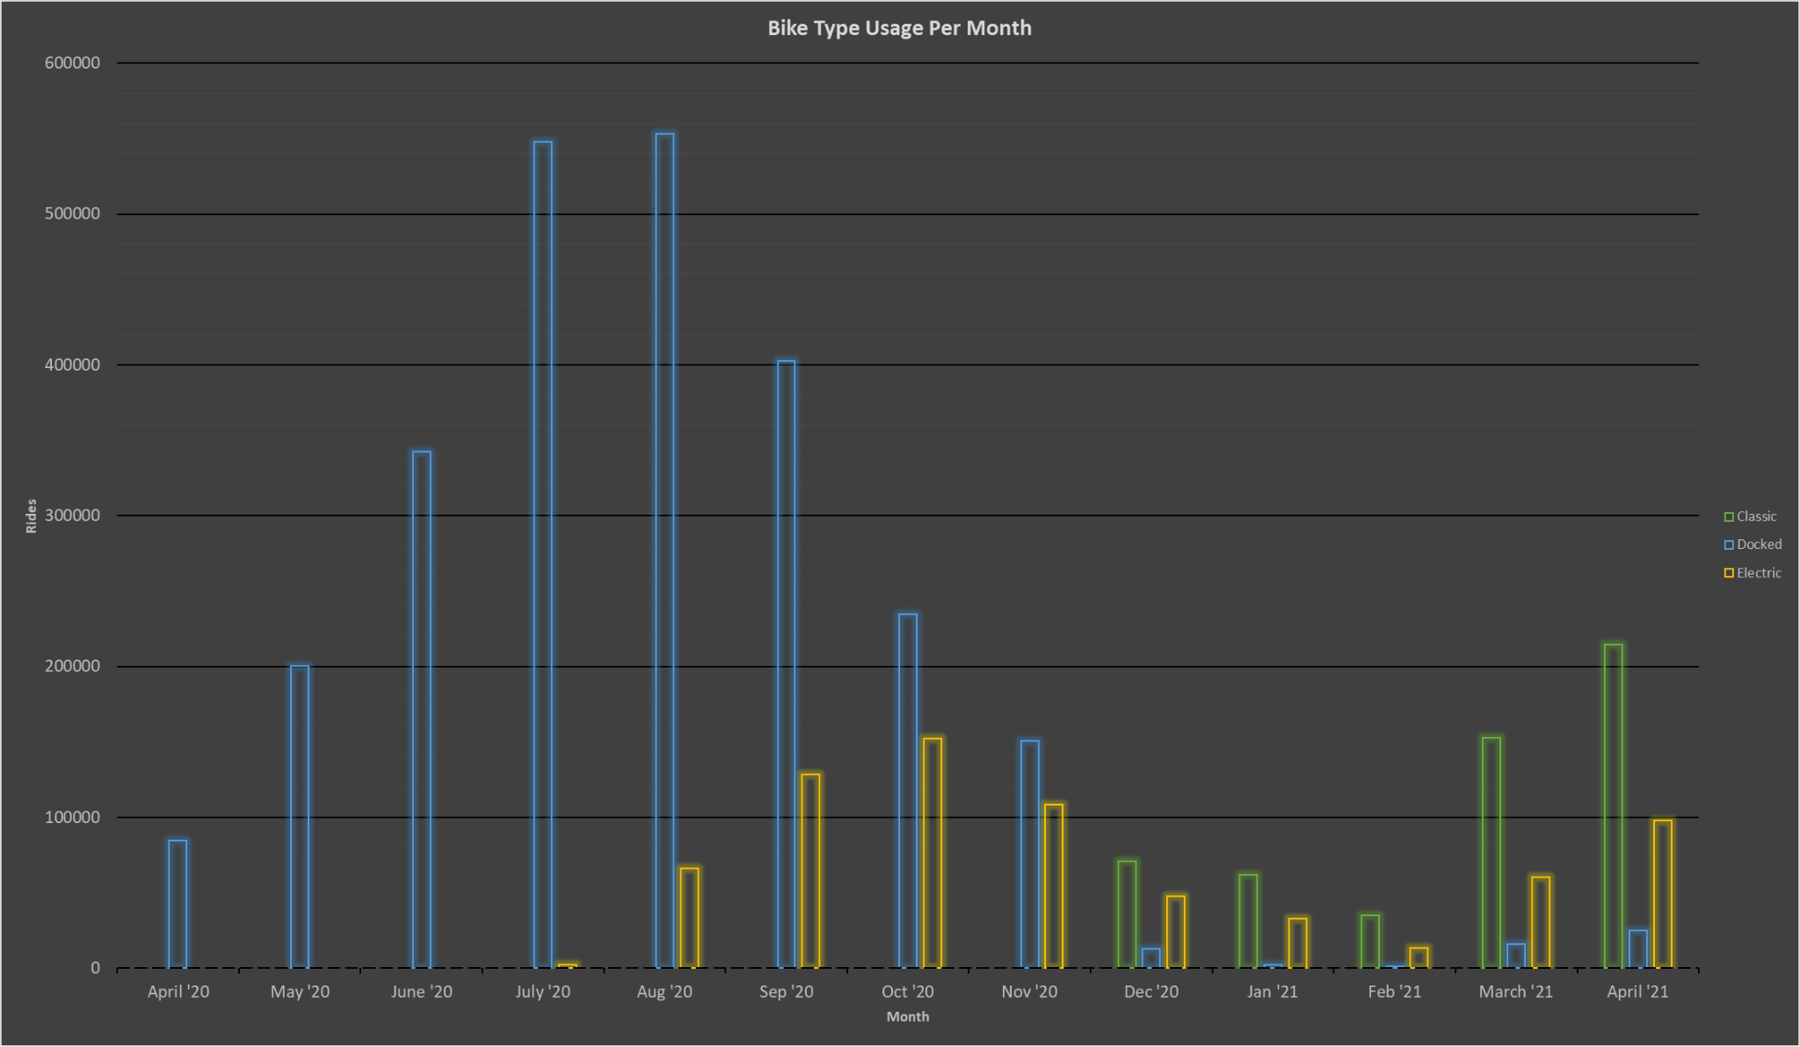
Key Findings
What They Ride
Docked Bikes
Most used bike but actually the least popular once others are implemented
From 100% in June’20 to >8% in Nov
Electric Bikes
Introduced in July’20 at 0.35%
41% of Monthly rides by Nov’20
Classic Bikes
Implemented in Dec’20
53% of total rides in first month
Never drops below 63% after the first month

Slide 9
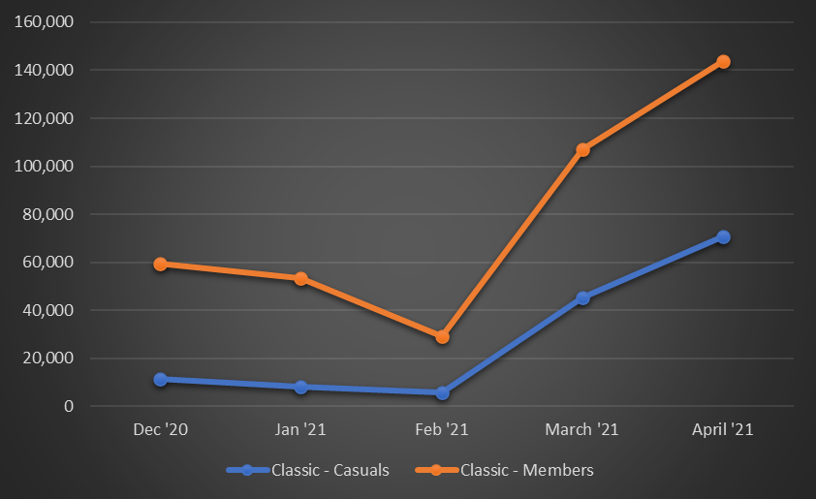
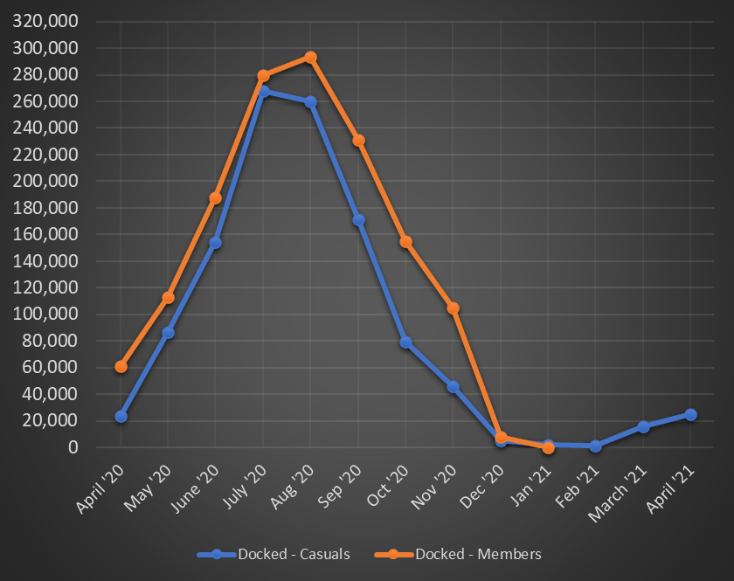
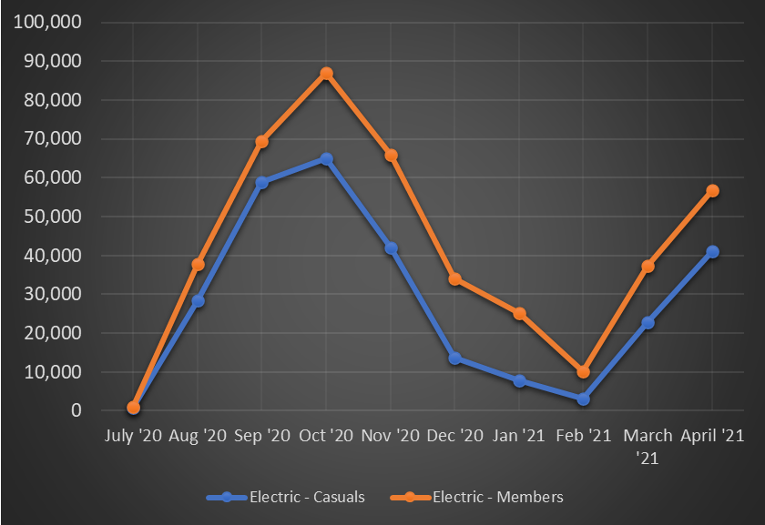
Key Findings
What They Ride Pt.2
Classic Bikes
Very Popular with both riders
Most popular bike with both riders
Docked Bikes
Members completely stop using docked 1 month after Classic bikes are implemented
Casuals continue using but it’s the least popular
Electric Bikes
Also very popular
Second most popular bike

Slide 10
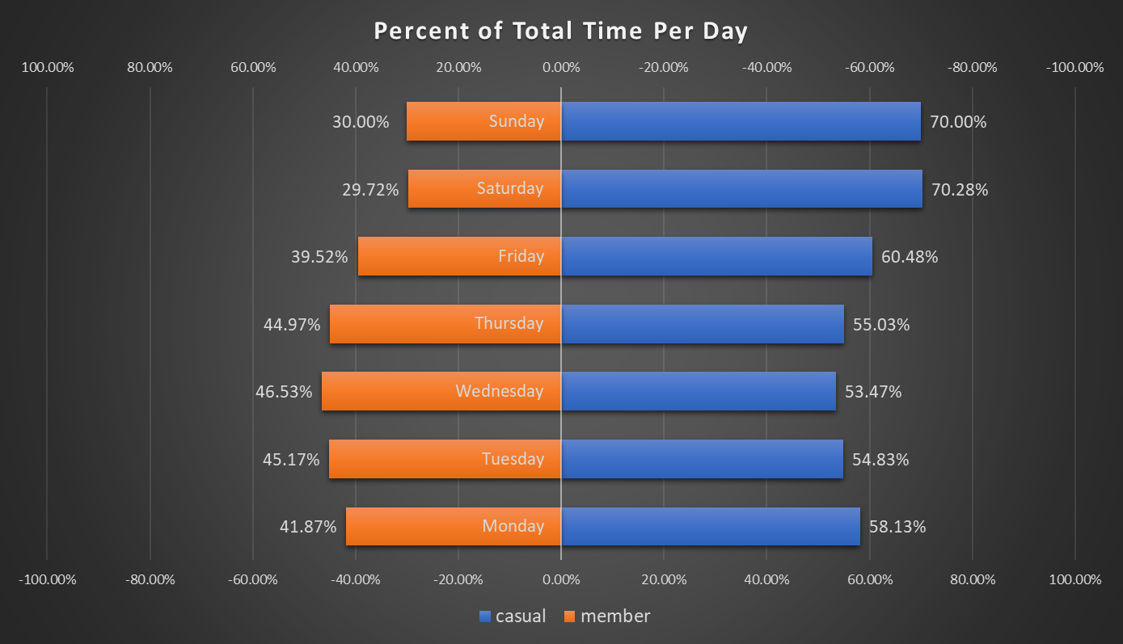
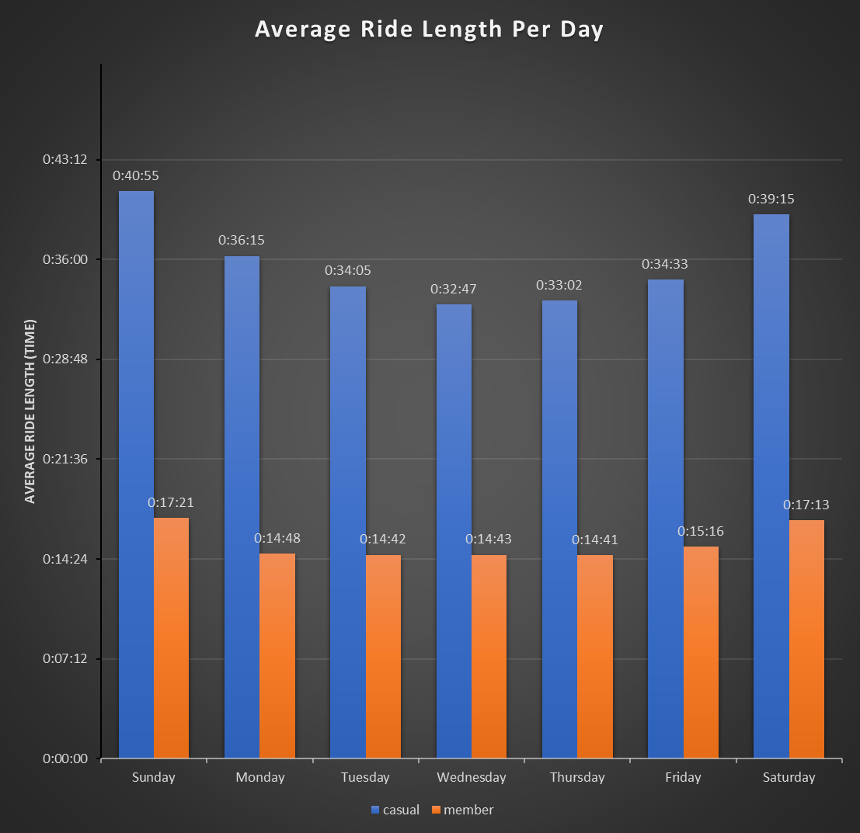
Key Findings
How Long They Ride
Casuals
Make up 41% of rides
Average ride time is Double that of Members
At least 54% of total ride time each day
70% of total ride time on Saturday and Sunday
Members
Does not like riding in Winter but still rides
Possibly due to commutes, dominates Winter ride % at a little over 80%

Slide 11
Summary of Findings
Members Are Consistent Riders
Casuals May Commute Sometimes
No one Likes Riding in Winter
Casuals prefer weekends and riding for leisure
Not as strong as Members, but trend shows more activity in rush-hours
Some members still find ways to ride, likely commuting
Summer is Our Biggest Season
New Bikes Are Popular
Casuals Use Cyclist Bikes A Lot
Tourists may also boost our numbers
Docked bikes aren’t used at all by Members
Ride times for Casuals exceeds Members in average and total time

Slide 12
Let’s Get (Casuals) To Work!
Use the Cyclistic app to notify users how close the nearest stations are
Casuals become aware of the availability and consistency of Cyclistic. Casuals know that the bikes are reliable and near their place of work or school
Casuals using bikes to commute leads to them using the bikes daily resulting in subscriptions for convenience and price
Digitally market to highlight Cyclistic stations near where most of the workforce and students are located
Through social media advertise the ease and convenience of riding to work
Marketing Opportunity 1
Casuals Are Open to Commuting

Slide 13
Fun Near You!
Alert users to events, new shops, and entertainment near Cyclistic stations
Casuals now know Cyclistic bikes can get them to their favorite events and locations around the city and regular outings can be done with Cyclistic bikes
Casuals are using their bikes to get to their favorite places, reach the crowded events on time, or make the unplanned stop. This makes the subscription more valuable and useful
Partner with local events to ensure Cyclistic bikes are accessible and popular outings(bars, clubs, gyms etc.)
Casuals becom Members as they use the bikes more regularly to do things they enjoy
Use app email and social media channels to send out these notifications
Marketing Opportunity 2
Casuals Ride for Leisure

Slide 14
Spending Time, Not Money
Track bike times and distances and notify users of their stats thru the app
Casuals are more aware of their heavy bike usage and in turn are aware of how important Cyclistic bikes are to them. They’re also aware of offers to become Members and possible offers of becoming one
Casuals capitalize on the deal we offer for subscription and are enticed by the offers presented toward Members. An annual membership saves money and has high value for those that ride so much.
Advertise to regular Casuals subscriptions or rewards only available after subscribing
Casuals becom Members as they use the bikes more regularly to do things they enjoy
Create milestones for distance, time and uses. Reward users for their patronage
Marketing Opportunity 3
Casuals and Their Prospective Cost

Slide 15
Meet In The Middle
Casuals may be reluctant to buy a full membership because many of them may only bike on the weekend. The option to become a semi-Member may be appealing.
Casuals sign up for the annual weekend pass. They will eventually want to use their bikes on a weekday sometimes and will see the appeal of a full Membership, possibly converting.
Casuals becom Members as they use the bikes more regularly to do things they enjoy
Offer Annual Weekend-Only Passes. Restrict some benefits.
Marketing Opportunity 4
Casuals Are Weekend Riders

Slide 16
Other Options
Discounts
Bike Privileges
More Data
While a private discount to regular and heavy Casual riders could be implemented with Opportunity 3, a public discount is also an option. There isn’t any data to support a public discount.
Gating Electric or Classic bikes behind a Membership or allowing Members to reserve bikes is also an option. This could be a dual-edged sword. Casuals ride for fun, not necessity. They could be enticed to become Members in order to ride the bikes they want or just as easily stop riding all together
There are other opportunities to convert Casuals, however analysing those opportunities without data isn’t recommended. We would be much better off with data concerning income, age, affiliations, and locations.

Slide 17
Thank You!
By Chevar Pryce
prycechevar@gmail.com or chevy1220@gmail.com
214-566-3863
Sources
Data (April 2020 - April 2021)

